Slide 1
Introduction to Lugu Health Station
Director:Dr.Hsi-chien Hu,MD.

Slide 2
Geography of Lugu Township

Slide 3
Lugu Township
Belongs to Nantou County, located in the central portion of Taiwan
A rural, mountainous, and scenic township
Total land scale：149 km²
13 villages and 7,763 households
Population density：127 persons/km²

Slide 4
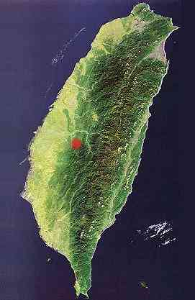
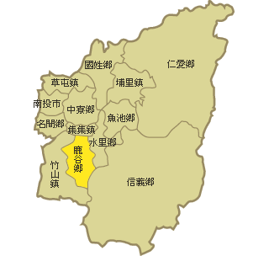
Lugu
Lugu
Nantou County
Nantou County

Slide 5
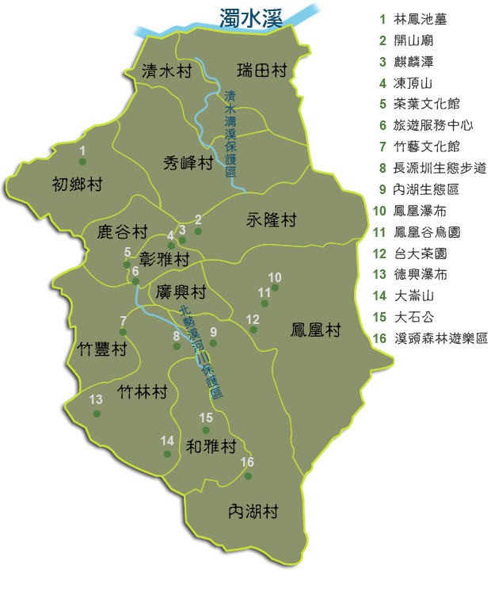
Jurisdiction
A total of 13 villages, the following diagram jurisdiction :
Lugu Township
Notes:
5

Slide 6
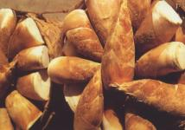
Local Culture
Agriculture
Main crops：
tea bamboo shoot

Slide 7
Demography of Lugu Township

Slide 8
Demography
Total population：17,808 till Dec. 2017
Male：9,511 ，Female：8,297
Aged population rate： 3,793/17,808=21.29%
Dependent population rate：29.0%

Slide 9
Age Structure
Person
Total
Male
Female
Age
Age

Slide 10
Vital Statistics

Slide 11
Vital Statistics
Crude birth rate in 2017：6.96 ‰
Crude death rate in 2017：12.01 ‰
Natural growth rate in 2017：-5.05 ‰
Infant mortality rate in 2017：0‰
Maternal mortality rate in 2017：0‰

Slide 12
Trend of Natural Growth Rate

Slide 13
Ten Leading Causes of Death in 2010

Slide 14
Organization and Manpower of Lugu Health Station

Slide 15
Manpower of Lugu Health Station
Physician：1
Head nurse：1
Public health nurses：5
Pharmacist：1
Lab technician：1
Radiology technician：1
Clerk：1
Ambulance driver：1
Cleaner：1
Volunteers：48

Slide 16
Organization Chart
Physician and Director
Head Nurse
Clerk
Ambulance driver
Cleaner
Radiology technician
Lab Technician
Pharmacist
4 Nurses

Slide 17
Medical Affairs

Slide 18
Medical Affairs
Administration of healthcare organizations
Administration of medical professional practices
Medical advertising regulations and enforcement
Long-term care
Psychiatric health
Prevention of suicide
Prevention of domestic violence and sexual assault
Disaster and emergency network
Activity assistance and rescue dispatch
Post-mortem examination

Slide 19
Medical Resources
Health station：1
Western Medicine Clinics：3
Chinese Medicine Clinics：1
Dental clinics：2

Slide 20
Number of People Received Medical Care
Outpatient services
23,070 in 2017
Medical service for remote districts
3,083 in 2017
Physical exam
203 in 2017

Slide 21
Pharmaceutical Affairs

Slide 22
Pharmaceutical Affairs
Pharmaceutical advertising regulations and enforcement (including drugs, cosmetics and medical equipments)
Inspection of illegal pharmaceutical products (including illegal drugs, cosmetics and medical equipments）
Inspection of controlled drugs
Prevention of substance abuse and promotion of drug-use safety
Administration of pharmaceutical dealers, drug stores, and pharmacists’ practice

Slide 23
Number of Drug Stores
Drug stores：6
Traditional Chinese Drugstores：6

Slide 24
Food Safety and Inspection Activities

Slide 25
Food Safety and Inspection Activities
Sanitation Management of food dealers
Food advertising regulations enforcement
Management of hygiene in public dining areas and restaurants
Food sanitation and nutrition education
Surveillance on outbreak of food poisoning

Slide 26
Health Promotion

Slide 27
Affairs of Health Promotion
Maternal, infant and genetic health
Child and adolescent health promotion
Prevention and control of chronic diseases for adults and elderly
Cancer control and prevention
Cervical cancer
Breast cancer
Oral cancer
Colon cancer
Tobacco control
Community-based integrated preventive health care services

Slide 28
Number of Spouses of Foreign Origins
Country | No.
China Mainland | 139
Japan | 4
Indonesia | 55
Kampuchea | 9
England | 1
USA | 2
Thailand | 3
Philippines | 8
Vietnam | 149
Korea | 7
Total | 371

Slide 29
Disease Control and Prevention

Slide 30
Affairs of Disease Control and Prevention
Prevention & control of epidemic disease
Immunization
Occupational sanitation

Slide 31
Vaccination Rate
Item | Rate
BCG | 100.00%
HepB3 | 99.01%
MMR | 94.06%
DTaP3+IPV3+Hib3 | 99.01%
DTaP4+IPV4+Hib4 | 87.00%
JE3 | 96.33%
Var | 93.07%

Slide 32
Laboratory Testing

Slide 33
Lab Items
Biochemistry：Chol. TG. HDL.LDL. Glu.
BUN. Cr. UA.GOT. GPT.
TSH.Free-T4. Anti-HAV.
HBsAg. Anti-HCV. HbA1c.
Microalbumin.RA factor…etc.
Urine exam：Urine Routine .
Blood exam：Blood Routine. Blood Type
Test for venereal disease ：VDRL. Anti-HIV.
Biological exam：EKG

Slide 34
Vision
We are striving to provide a continuing, comprehensive, and coordinating care for our residents. And we believe the dream will come true someday.

